Slide 1
Function Return, Parameters,
Invocation
This lecture describes a function's return statement and parameters with respect to their arguments
Topics discussed in this section:
Return Statements
Parameters
Function Call/Invocation

Slide 2
Function Return Statements

Slide 3
Function Local Variables

Slide 4
Note
Formal Parameters, Actual Parameters (Arguments)
Formal parameters are variables that are declared in the header of the function definition.
Actual parameters, also called Arguments, are the expressions in the calling statement.
Formal and actual parameters must match exactly in type, order, and number.
Their names, however, do not need to match.

Slide 5
Parts of a Function Call

Slide 6
Examples of Function Calls

Slide 7
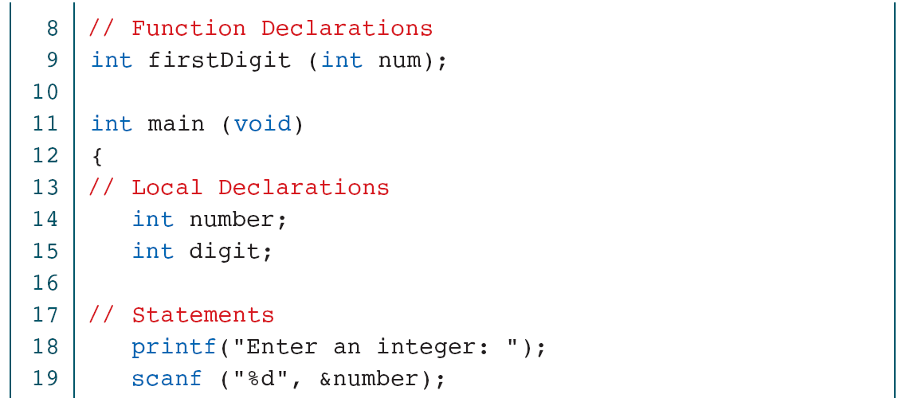
Print Least Significant Digit

Slide 8
Print Least Significant Digit

Slide 9
Print Least Significant Digit

Slide 10
Design for Add Two Digits

Slide 11
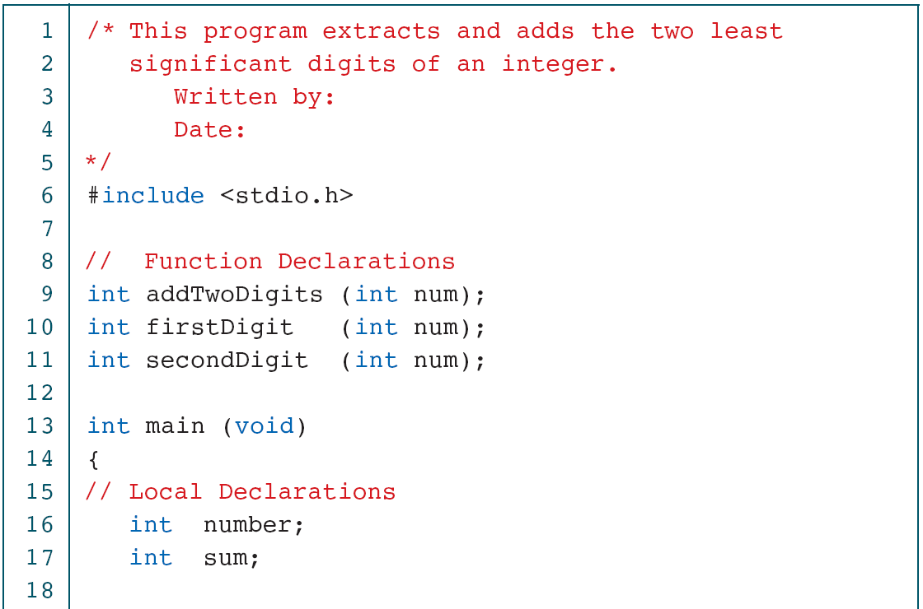
Add Two Digits

Slide 12
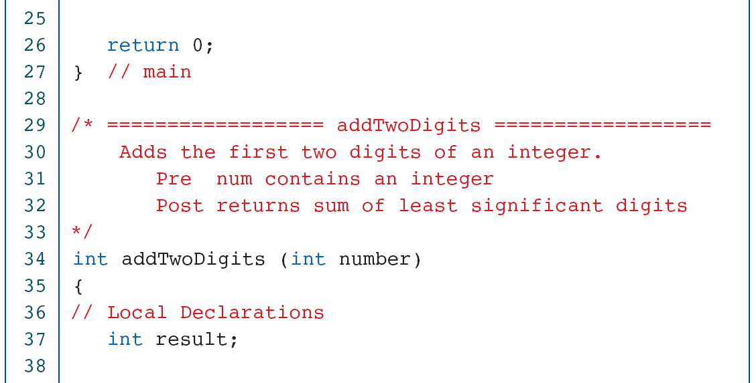
Add Two Digits

Slide 13
Add Two Digits

Slide 14
Add Two Digits

Slide 15
Print Six Digits with Comma

Slide 16
Print Six Digits with Comma

Slide 17
Print Six Digits with Comma

Slide 18
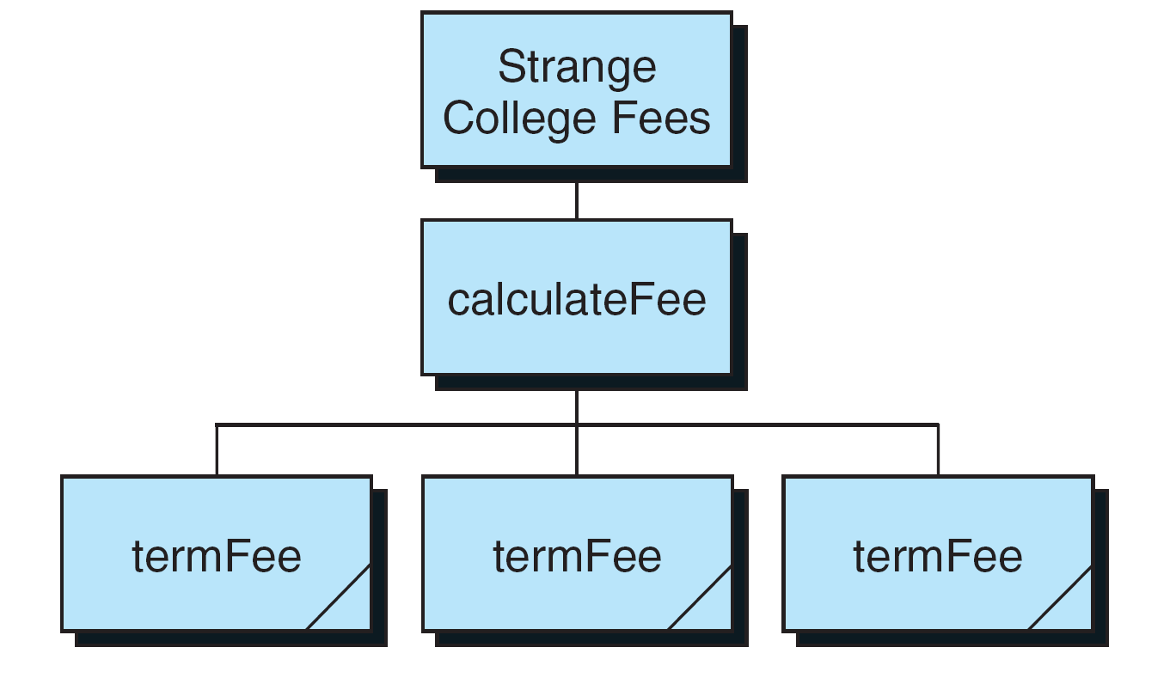
Design for Strange College fees

Slide 19
Strange College Fees

Slide 20
Strange College Fees

Slide 21
Strange College Fees

Slide 22
Strange College Fees

Slide 23
Strange College Fees

